Slide 1


Slide 2
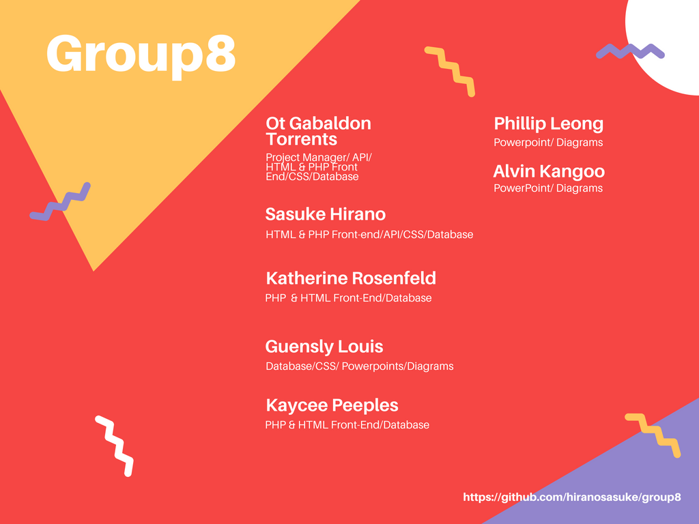

Slide 3
Challenges and setbacks(W/ Louis)
Lack of communication due to poor use of slack. Only a few members were initially using the software which made it difficult to pass on important announcements and information to the entire group.
Ineffectively distributed tasks without fully knowing or understanding the specifications of the project
The aforementioned led to loss of time and slowed down the development process.
Several group members were working on all parts of project in order to achieve a better understanding and provide functional, working prototypes.

Slide 4
What is the project?(W/ Alvin)
The project is essentially a software, known as a contact manager ,that enables the user to store and retrieve basic contact information including names, addresses, and phone numbers.
Every feature and component including the front-end, API, database is being hosted via Amazon Web Services cloud.
The front-end of the contact manager allows for either user log-in or user sign up.
Landing page displays basic user info along with the current contacts stored under the active account.
The application gives the user the capability to add, edit, search, and delete contacts. It also provides the user the ability to assign pre-installed icons or upload pictures for each contact.

Slide 5
How was it developed?(W/ Phillip)
The project was developed using the agile method of software development
LAMP stack was used for application
Apache was used for website hosting
PHP used for both the front and back end to connect them
CSS used in the front end development of application while SQL was used for the database
User icons are created and toggled with JavaScript.

Slide 6
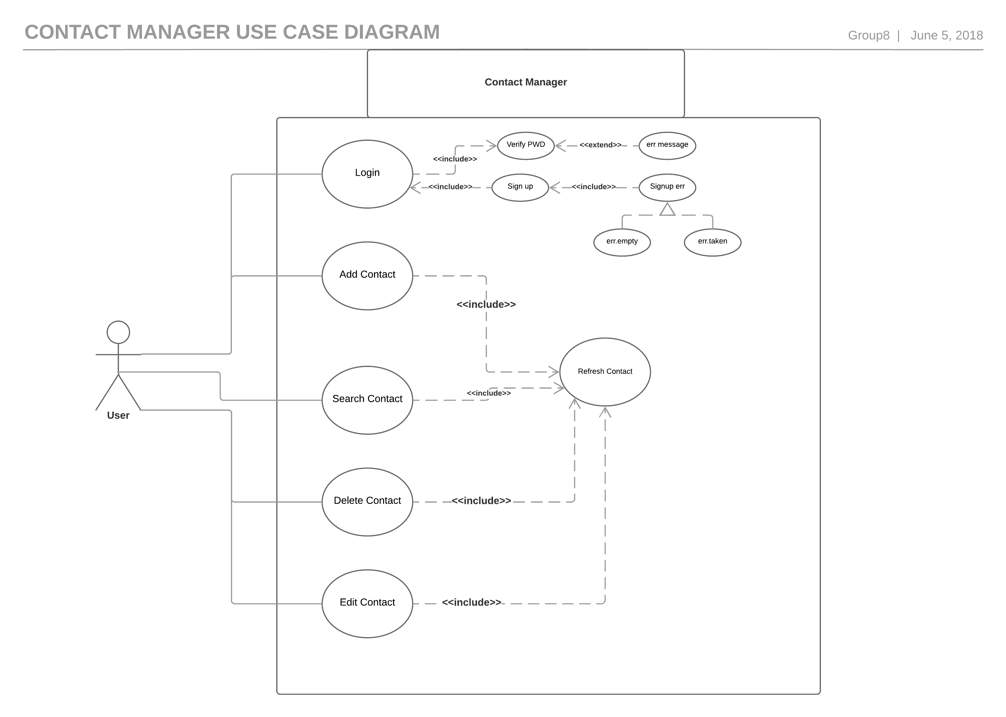

Slide 7
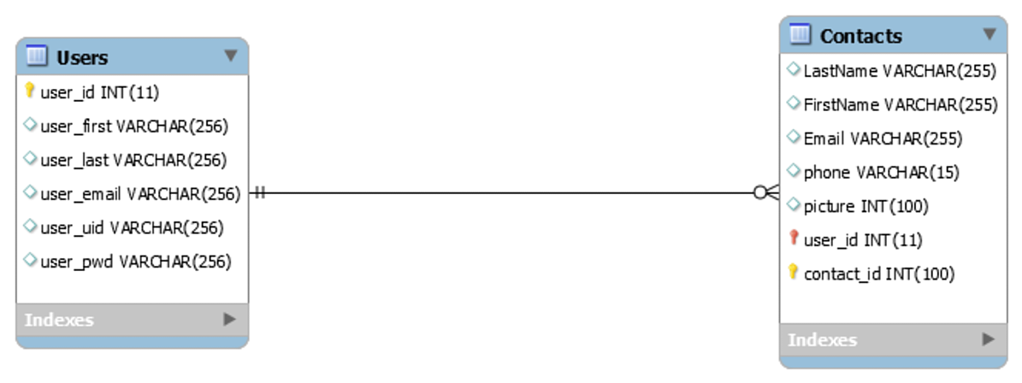
Entity Relationship Diagram(ERD)

Slide 8

DEMO

Slide 9


